Slide 1

Agenda
What is a SOC?
Tools
Lab
https://cyberdefenders.org/
WireShark
Brim

Slide 2

Lab @ https://cyberdefenders org/
Install Brim, WireShark
Create free account @ https://cyberdefenders org/
Under ‘Practice’ tab, Search ‘HoneyBOT’
Questions 1-12
https://cyberdefenders org/blueteam-ctf-challenges/45
Look for the Story
How does blank data fit into the bigger picture?

Slide 3
What is The Blue Team
Put simply, it's the defensive side of cybersecurity teams are responsible for defending an organization(s) assets
Security operations centers (SOC) are responsible for accomplishing this task
Every organization has different resources, cultures, polices, and regulations and thus prioritizes their assets differently
No two SOCs are alike

Slide 4
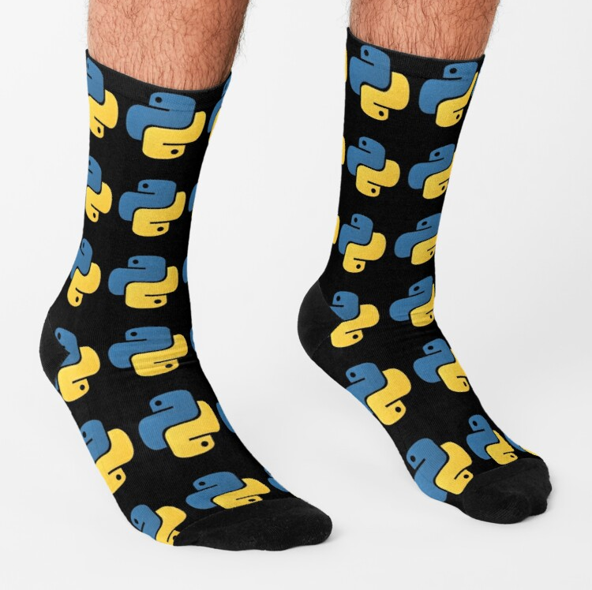
What is a SOC?
The primary duty of the SOC is to protect the organization against cyberattacks
Often these departments monitor 24/7
Depending on the organization it can extend to a facility's physical security as well

Slide 5

Types of SOCs
Internal (in-house)
responsible for in house assets
MSSP (outsourced)
Responsible for monitoring and or protecting client's assets
the scope what is monitored and the reach of any response from the MSSP is defined in the Service level agreement between the two organizations

Slide 6
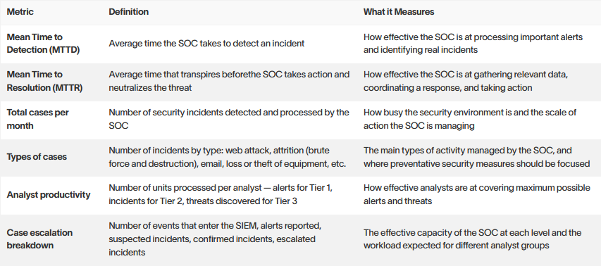
How to measure SOC effectiveness

Slide 7
SOC Roles
SOC Analysist
Incident Responder
Threat Hunter
Forensic Analyst
SIEM Engineer
SOC Manager
CISO

Slide 8
SOC Analysist
Defend customer security threats by monitoring for IOC
Perform investigations in response to security alerts with defense tools
Log-correlation and anomaly detection
Investigate, document, and report an information security issues

Slide 9
Incident Responder
Use SIEM and other monitoring tools for advanced analysis
1
Respond to attackers by implementing countermeasers
2
Support the development of operational and executive reports
3
Assist in defining and driving strategic initiatives
4

Slide 10
Threat Hunter
Proactively identify threats
To detect current threats, create and run custom analysis models using security event data
Contribute to the identification (hunting) and profiling of threat actors and TTPs (tactics, techniques, and procedures)
In the area of Threat collection, providing mentorship and support to peers

Slide 11
Forensic Analyst
Collect forensically sound artefacts from compromised machines in order of volatility
Preform forensics analysis on images using tools like volatility and Autopsy
Create reports indicating a timeline of events
log chain of custody
If incident is ongoing, provide updates to the IR team

Slide 12
SIEM Engineer
Manage, tune, and optimize SIEM tool
Maintain and suggest monitoring and analysis tools
Develop a structure that is secure and keeps the attackers outside
Will collaborate closely with senior engineers and threat analysts
Assists with the escalation of significant and complex customer issues, as well as product configuration and testing

Slide 13
SOC Manager
Lead and manage SOC
Create new operational rules, processes, and procedures to improve security procedures
Managing shifts / team in the 24X7
Handling escalated security incidents
Coordinate with stake holders

Slide 14
Lab @ https://cyberdefenders org/
Install Brim, WireShark
Create free account @ https://cyberdefenders.org/
Under ‘Practice’ tab, Search ‘HoneyBOT’
Questions 1-12
https://cyberdefenders.org/blueteam-ctf-challenges/45
Look for the Story
How does blank data fit into the bigger picture?

Slide 15

What is Wireshark?
Free and open-source packet analyzer
Easy to introduce, difficult to master
Good for looking at raw data

Slide 16

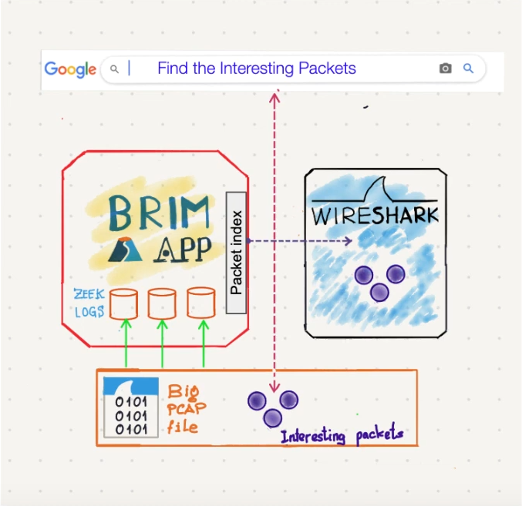
Brim
Faster, lighter, and friendlier compliment to Wireshark
Brim is to Wireshark, as SparkNotes is to Shakespeare
The summary is good, but sometimes you need a firsthand source

Slide 17

CVE
Common Vulneraries and Exposures
https://www exploit-db.com/
https://cve mitre.org
https://nvd nist.gov/
Google <exploit characteristics> + “Exploit database”

Slide 18
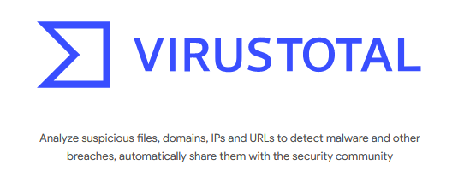
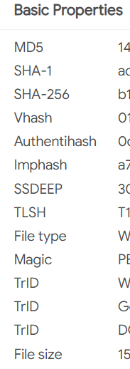
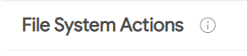
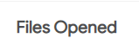
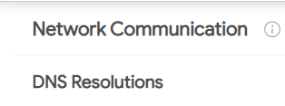
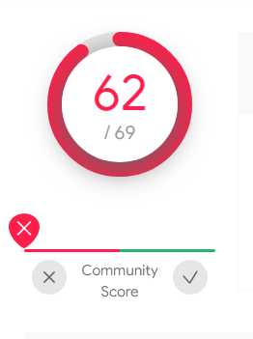
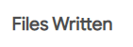
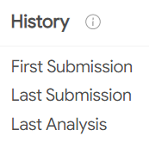
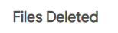

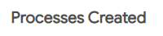

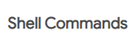

Slide 19

Questions?

Slide 20
Question 2
Question 1
What is the attacker's IP address?
What is the target's IP address?

Slide 21
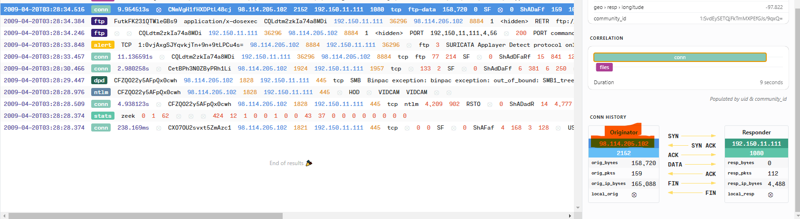
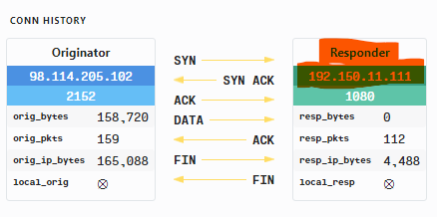

Slide 22
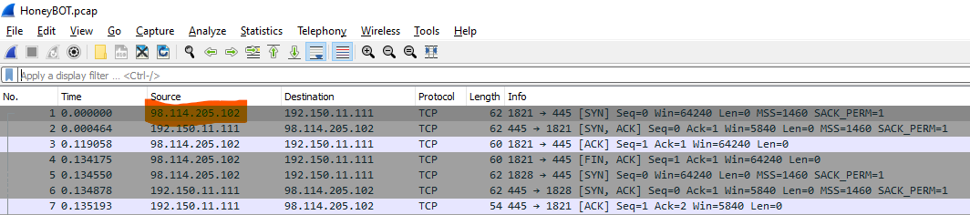
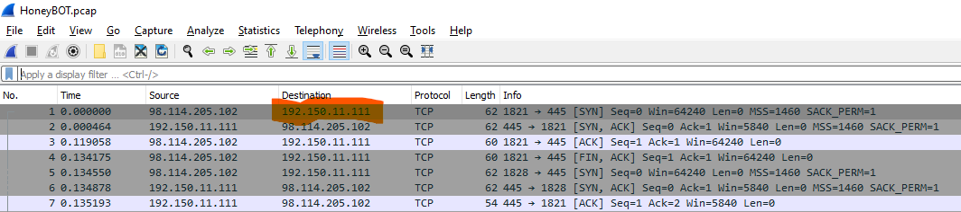

Slide 23
Q 3
Provide the country code for the attacker's IP address

Slide 24
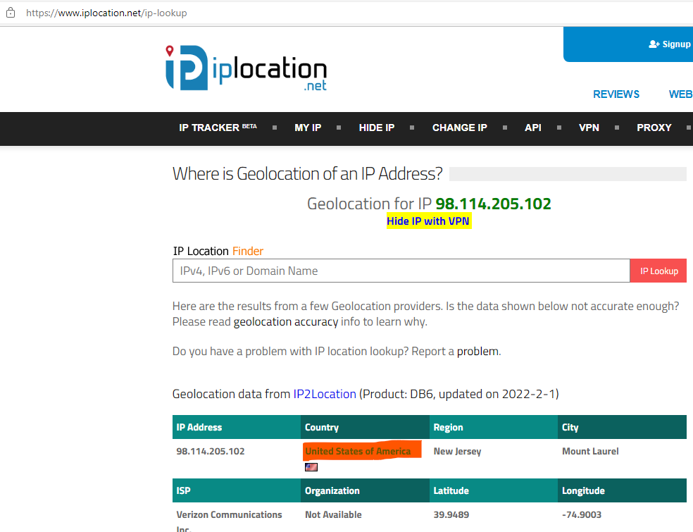

Slide 25
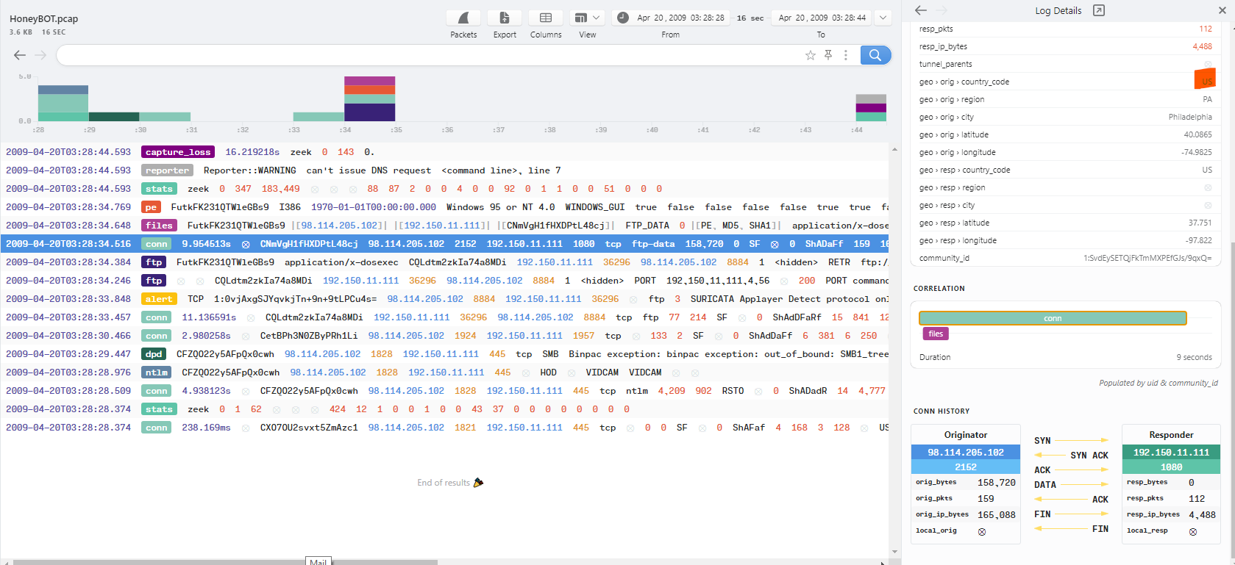

Slide 26
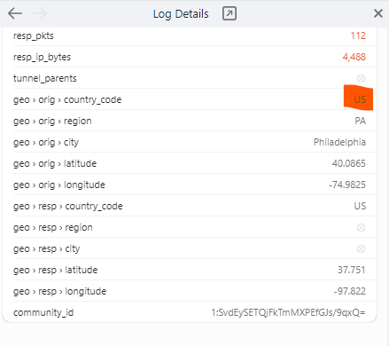

Slide 27
Q 4
How many TCP sessions are present in the captured traffic?

Slide 28
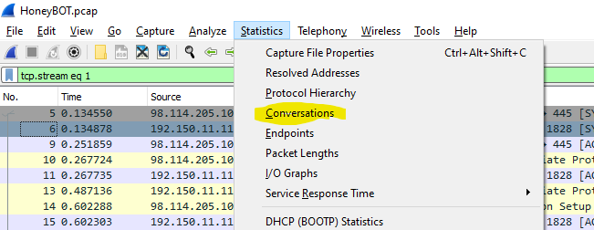
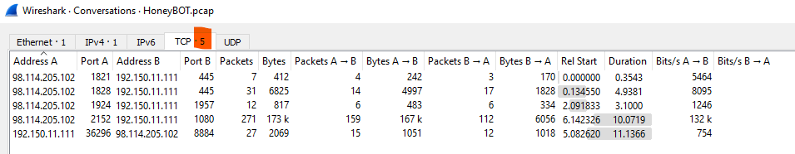

Slide 29
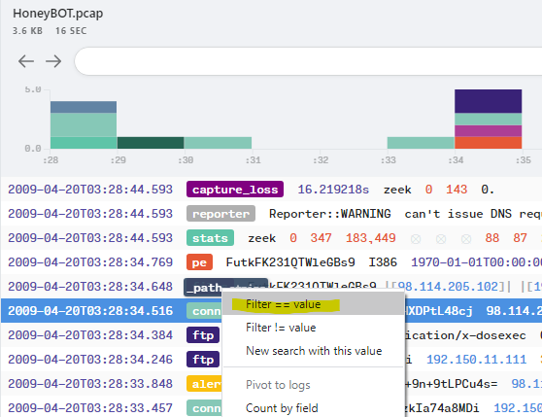
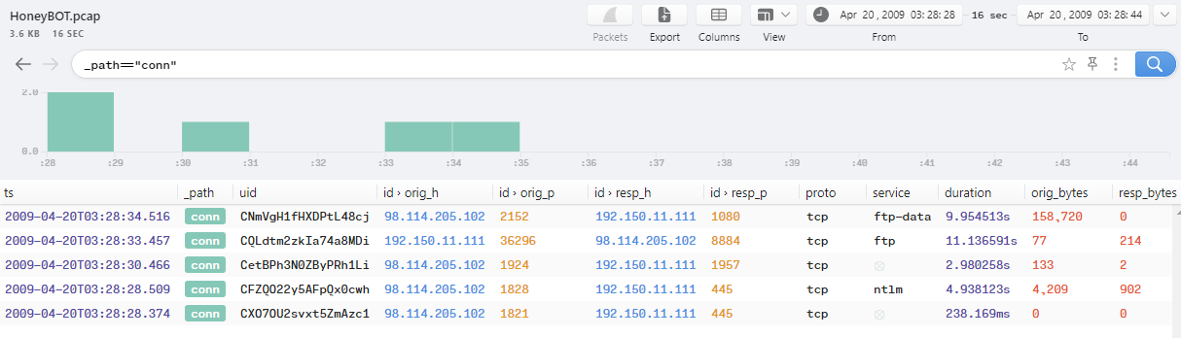

Slide 30
Q 5
How long did it take to perform the attack (in seconds)?

Slide 31
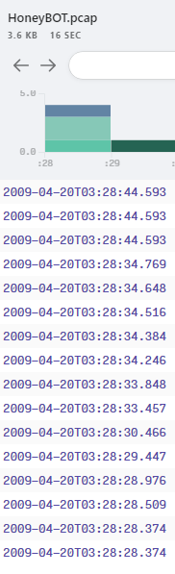
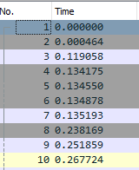
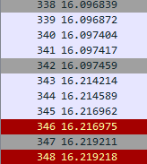

Slide 32
Q 7 (no Q 6)
Provide the CVE number of the exploited vulnerability

Slide 33
The Answer
tcp
smb
dcerpc
dssetup
DsRolerUpgradeDownlevelServerOverflow
No 33&38
DsRoleUpgradeDownlevelServer
google
DsRolerUpgradeDownlevelServer Overflow
https://www exploit-db com/exploits/16368
https://nvd nist gov/vuln/detail/CVE-2003-0533

Slide 34
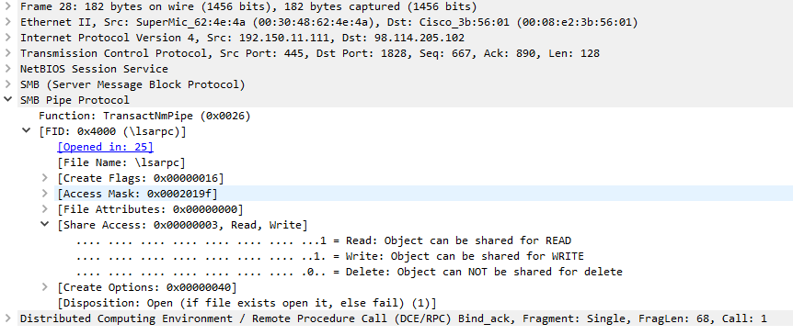

Slide 35
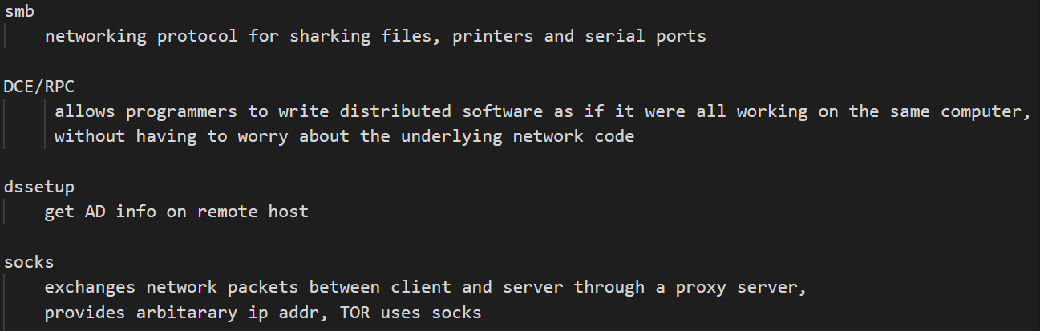
Research

Slide 36
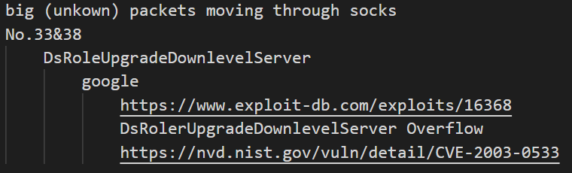

Slide 37
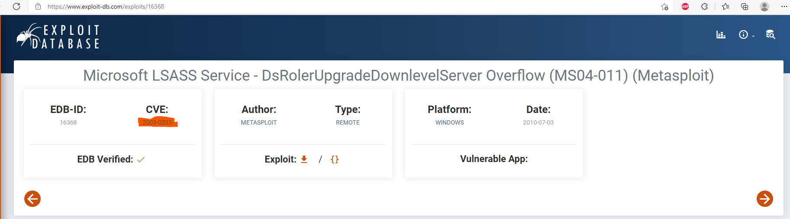
CVE-2003-0533

Slide 38
Q 8
Which protocol was used to carry over the exploit?

Slide 39
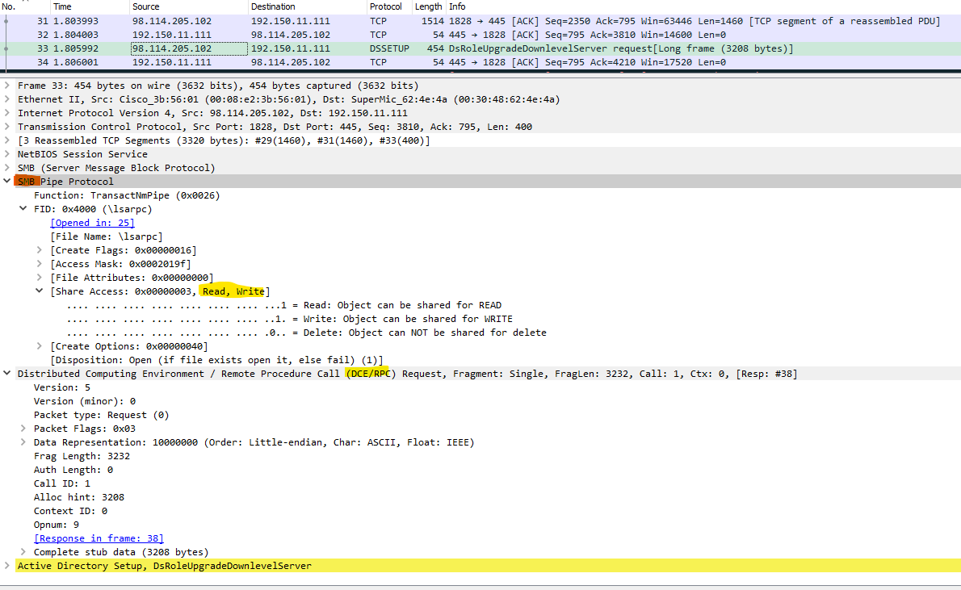

Slide 40
Q 9
Which protocol did the attacker use to download additional malicious files to the target system?

Slide 41
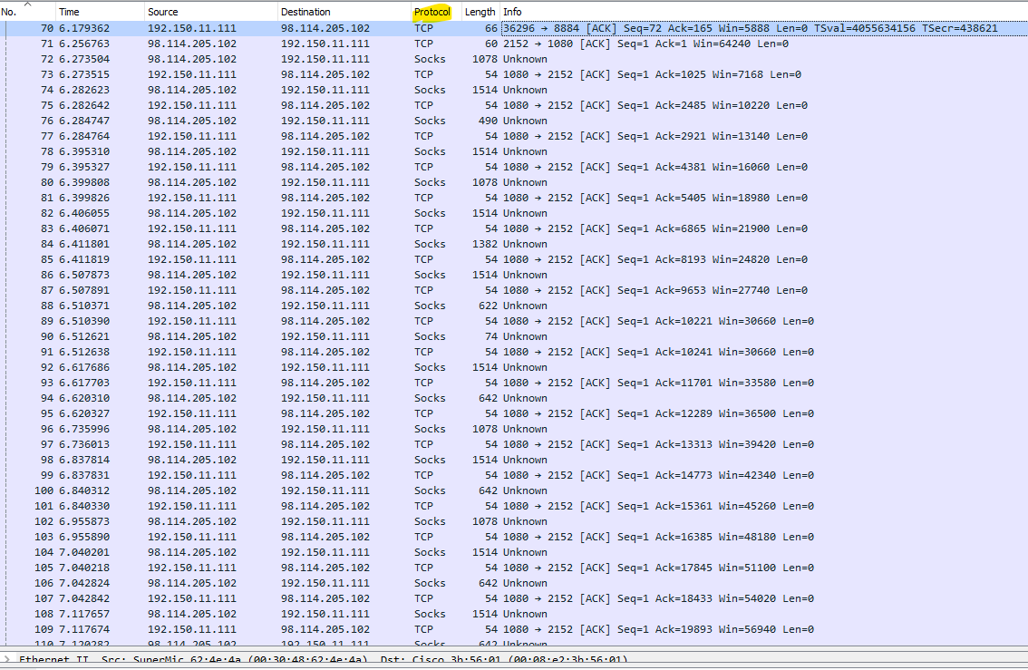

Slide 42
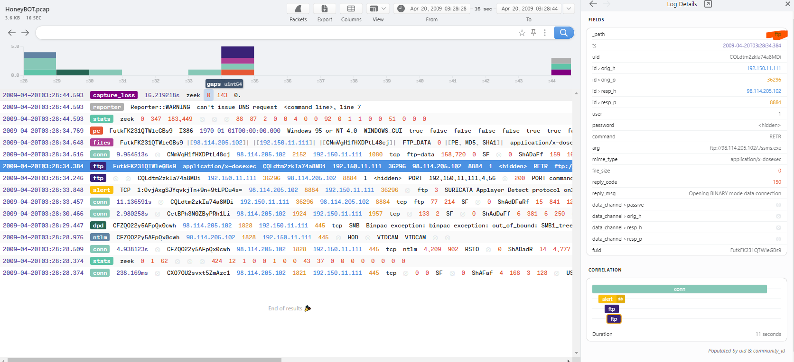

Slide 43
Q 10
What is the name of the downloaded malware?

Slide 44
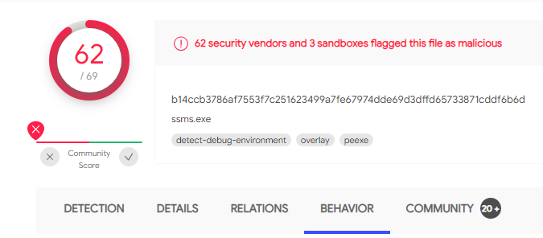
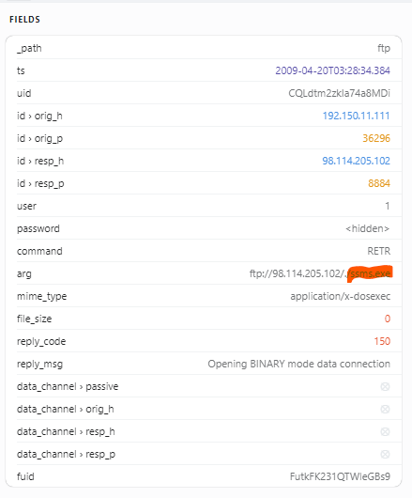
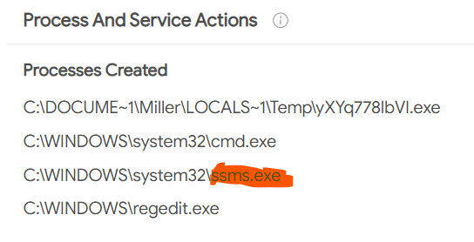

Slide 45
Q 11
The attacker's server was listening on a specific port Provide the port number

Slide 46
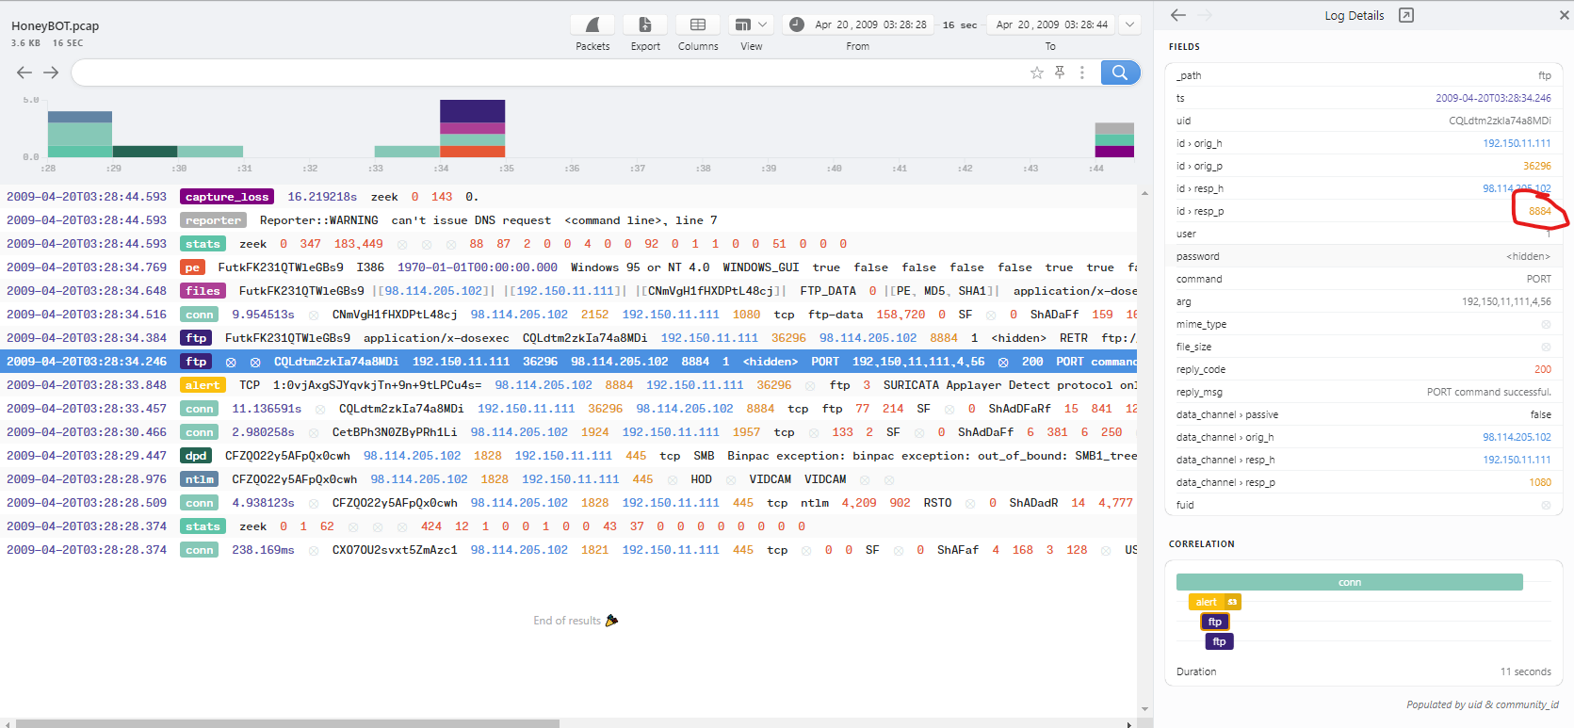

Slide 47
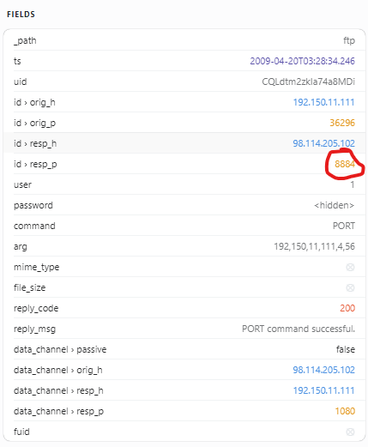

Slide 48
Q 12
When was the involved malware first submitted to VirusTotal for analysis? Format: YYYY-MM-DD

Slide 49
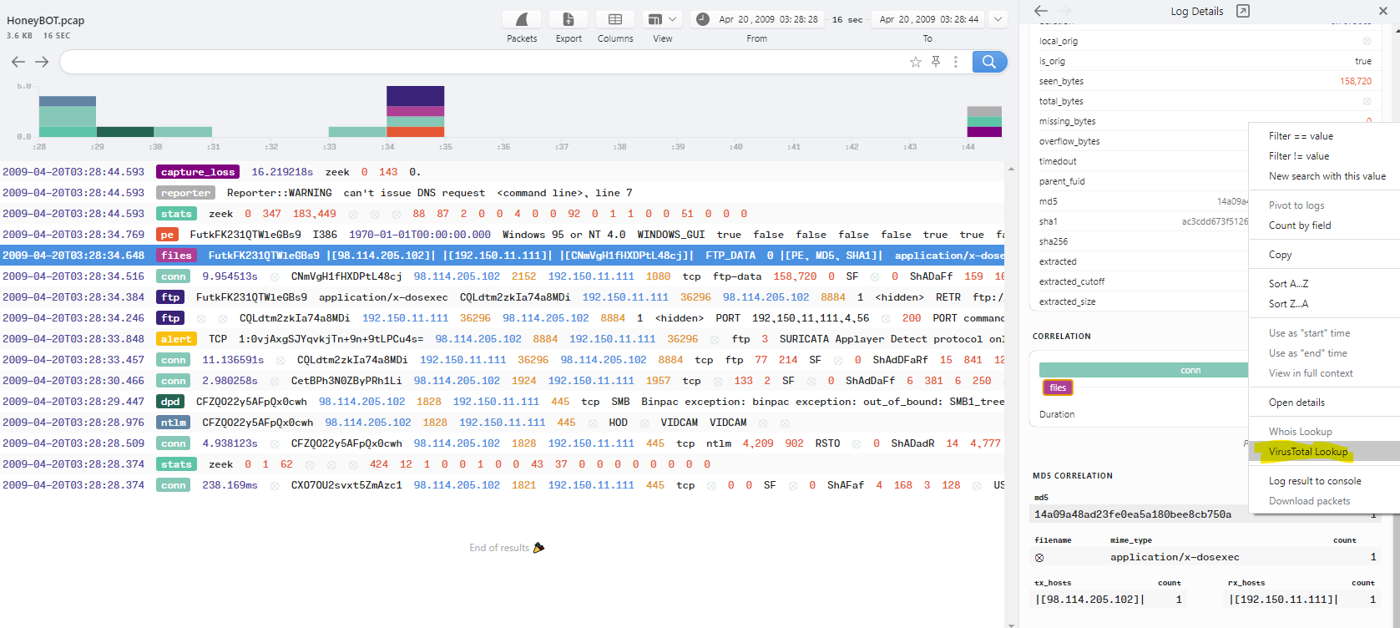

Slide 50
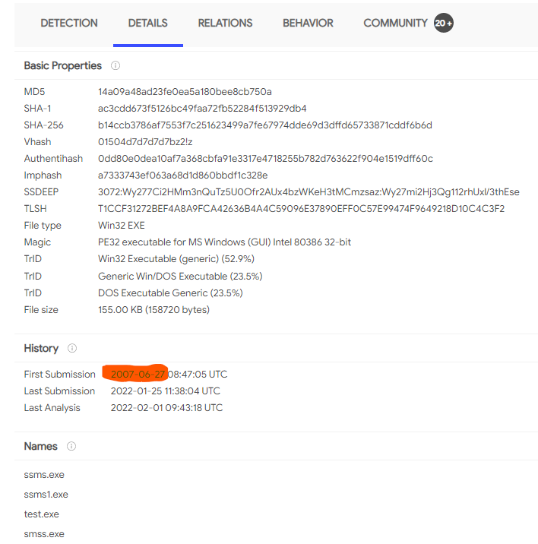

Slide 51

The Bigger Picture

Slide 52
Sources
https://www.checkpoint.com/cyber-hub/threat-prevention/what-is-soc/security-operations-center-soc-roles-and-responsibilities/
https://www.socinvestigation.com/security-operations-center-soc-roles-and-responsibilities/
https://www.datashieldprotect.com/blog/5-questions-to-ask-an-mssp
https://www.exabeam.com/security-operations-center/security-operations-center-roles-and-responsibilities/
https://www.infosectrain.com/blog/role-and-responsibilities-of-a-soc-analyst/

